Slide 1
GCworkplace Tour Program
25 Eddy 1st floor

Slide 2
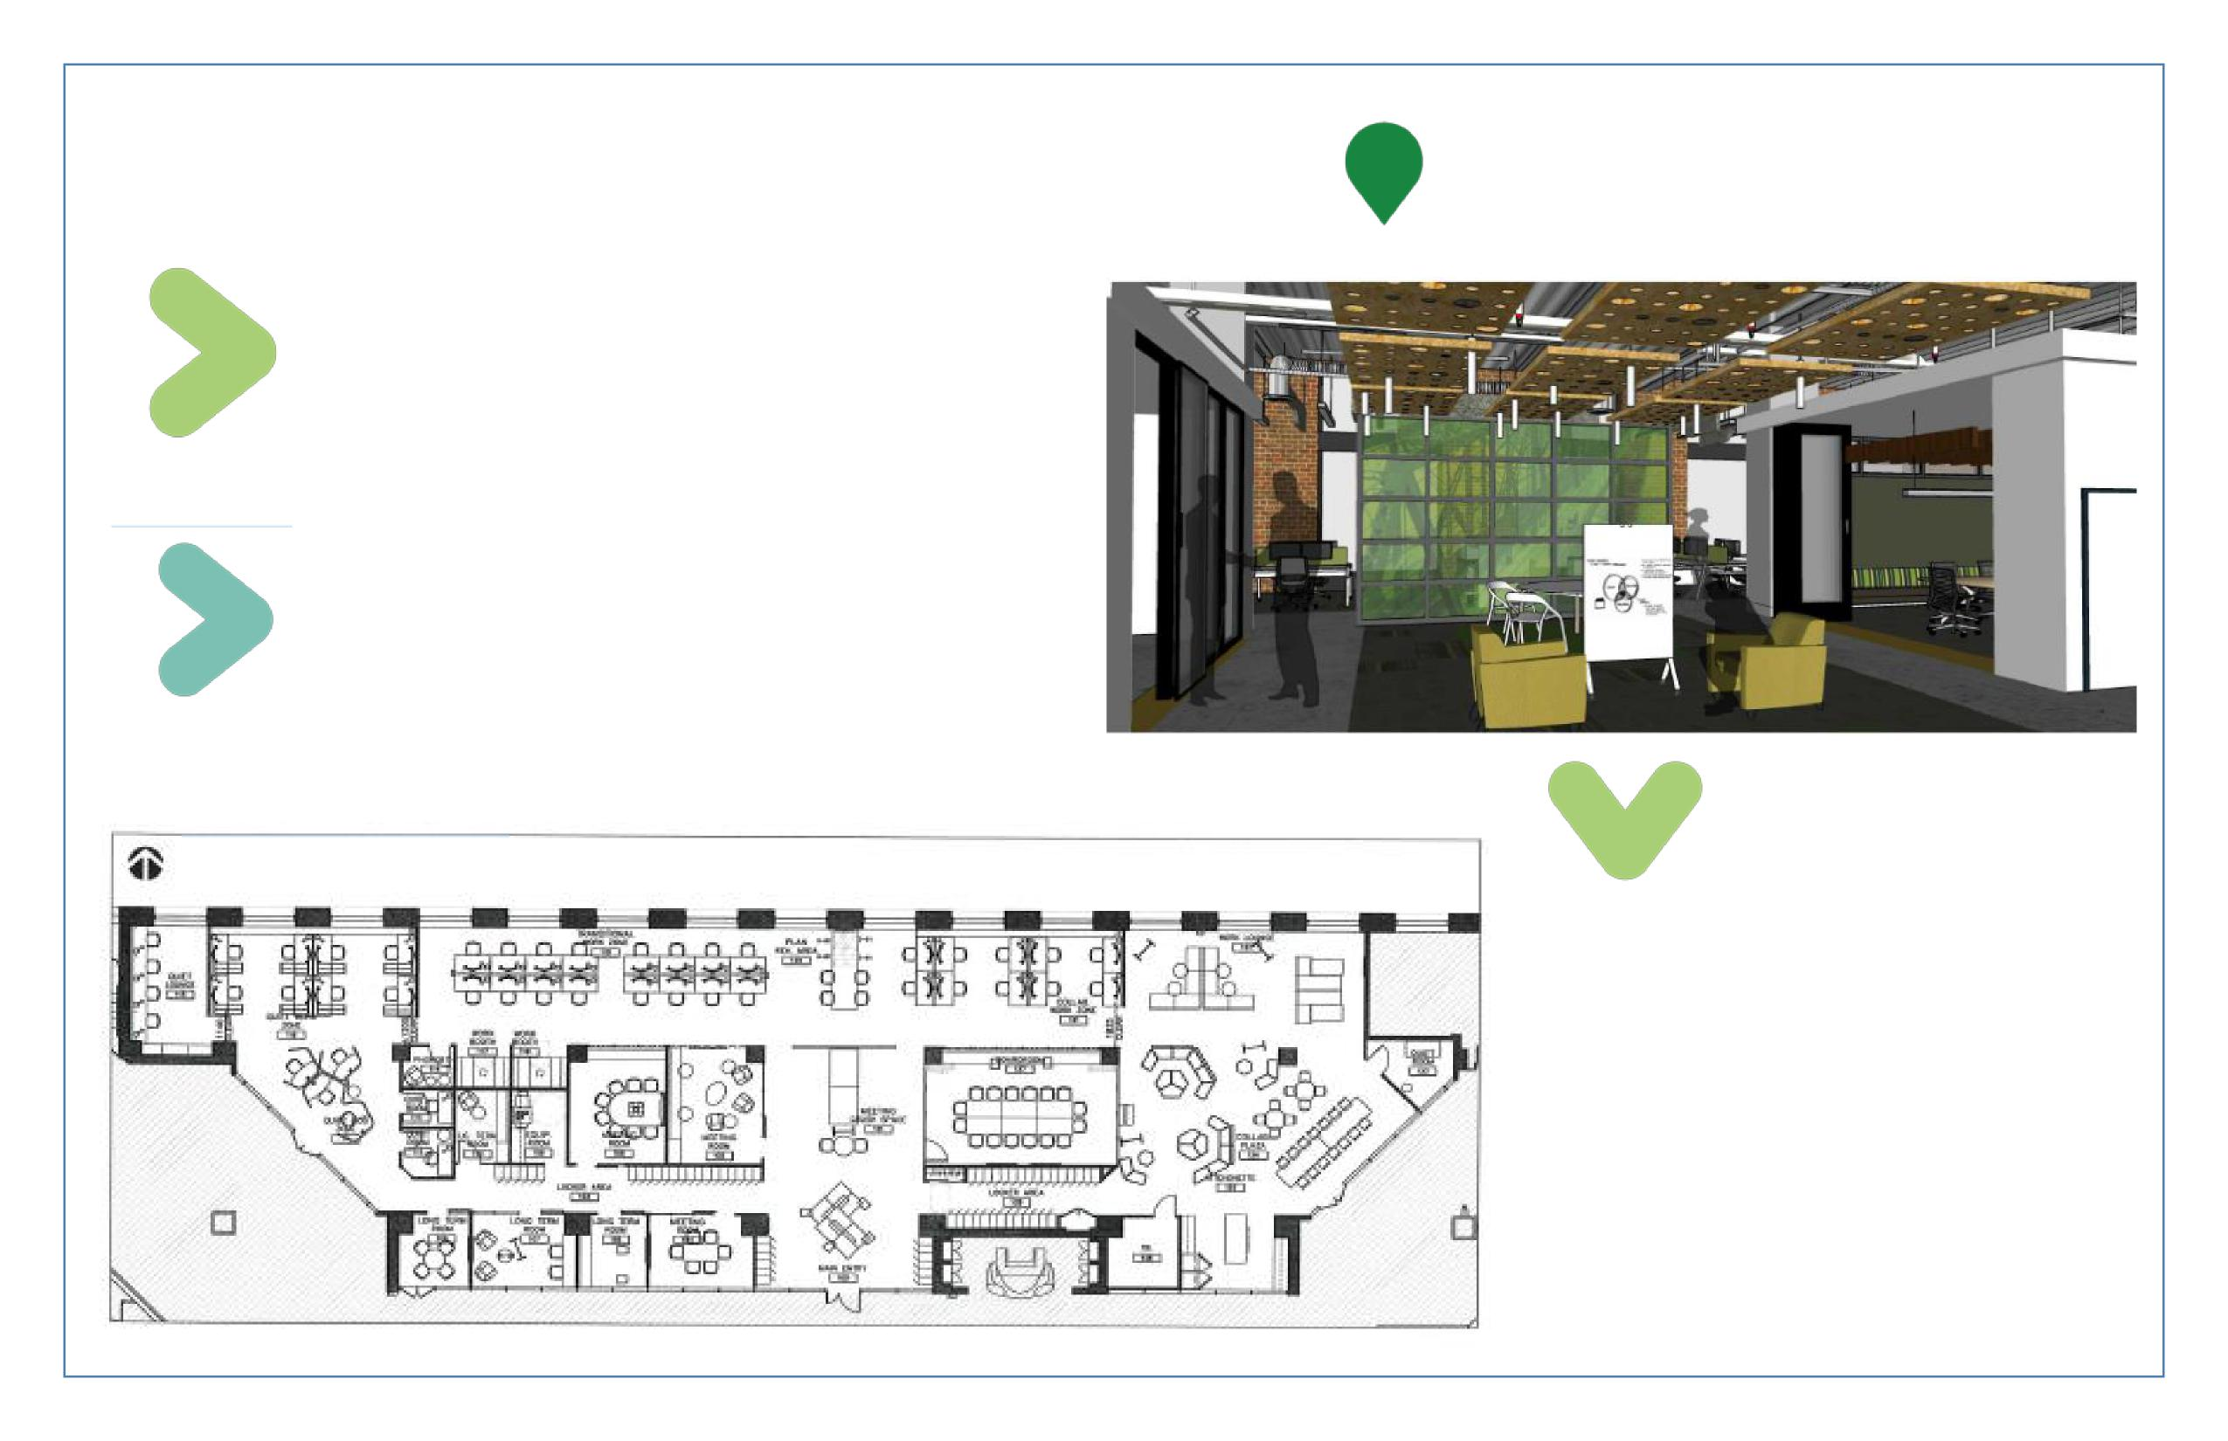
*** Click here to see the video tour of the 25 Eddy 1st floor***
SCOPE
Demonstration floor for the GCworkplace program
Workplace fully designed based on the activties of the organization
HIGHLIGHTS
2 monitors at all individual workstation
Integration of accoustic panels
Integration of wood panneling into the space
3 zones – Quiet, transitional and collaborative
Flexible seating in the collaborative zone
Multifunctional meeting room with retractable walls
QUIET ZONE TRANSITION ZONE INTERACTIVE ZONE
VARIETY OF WORKPOINTS
34 individual workstations
4 pods with privacy elements
6 collaboration spaces
6 meeting rooms
1 multipurpose meeting room with
retractable walls
1 phone booth
4 Quiet rooms
1 kitchenette
Notes:
GCworkplace is planned in a way that noise-generating workpoints and support spaces (lockers, kitchens…), such as collaborative workpoints, are away from individual workpoints in order to manage acoustics, flow of circulation, and better support concentration and collaboration. GCworkplace is designed in three functional zones –Quiet, Transitional and Interactive -which ensures that activities are grouped together to support functional requirements and reduce noise disruptions.
You can click on the link (top page) to see a video tour of the floor.

Slide 3
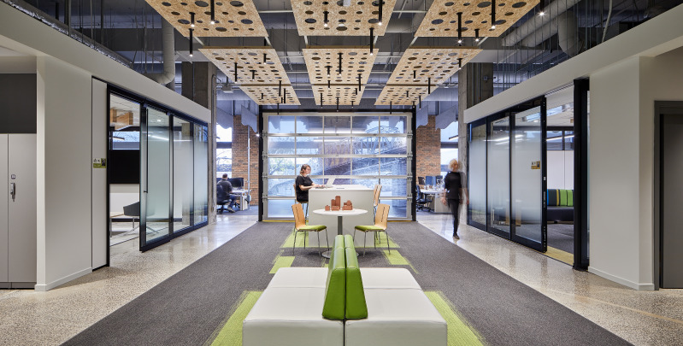
MAIN ENTRANCE
Notes:
The space is divided into 3 zones: a quiet zone, a transitional zone and an interactive zone. The various zones dictate the type of work that can be performed in these areas as well as the behaviors that are expected from employees working in these zones, mostly as it relates to noise levels.
We also have lockers that are keypad enabled – which removes the requirement for a dedicated role for key management. They are used as storage space by employees to store their personal belongings.
The main entry is purposely large and spacious to allow employees and visitors space to gather before and after larger meetings, with drop-down areas (lounge seats, small table and larger bar counter) to continue discussions – a key functional adjacency to the large boardroom and project rooms that open off the space.
This area can also be used for social gatherings or client engagements.

Slide 4
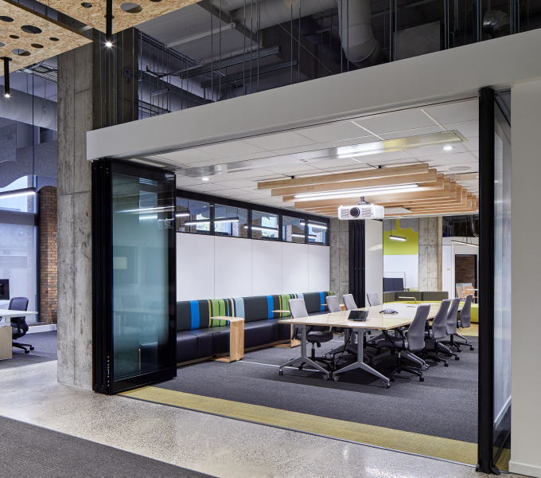
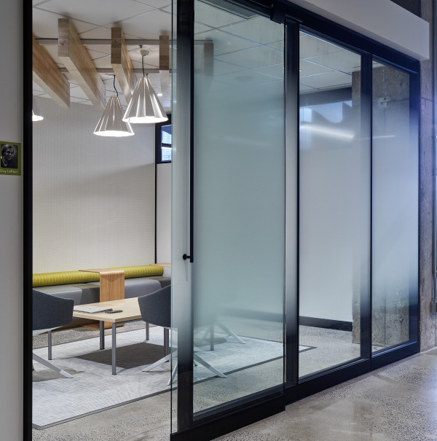
LARGE MEETING ROOM
PROJECT ROOM
Notes:
The layout of this space has allowed the designers to propose the alignment of most enclosed meeting rooms. Mainly since the natural light comes in from where most workpoints are located.
The capacity of the meeting rooms in the meeting corridor reduces once getting closer to the quiet zone. This helps to manage the noise level in this zone and has allowed the designers to propose the alignment of most enclosed meeting rooms.
All meeting rooms are equipped with AV and the ClickShare technology and there is one meeting room equipped with videoconference equipment.
The larger meeting rooms are bookable through Outlook while the others are meant to be used more spontaneously. Wi-Fi is available everywhere on the floor.
This part of the floor also includes the Business Center. Employees can find a multi-functional device (printer with fax and scanner), supplies and common work tools in this location.
In addition to more traditional meeting rooms with a large table and chairs, there is a project room that features lounge seating, writeable walls and furniture that can be reconfigured for various team activities (left image above)
In the large boardroom (right image above), a screen descends from the ceiling for presentations, and the walls at the far end open up to expand capacity for townhalls/all-staff sessions.

Slide 5
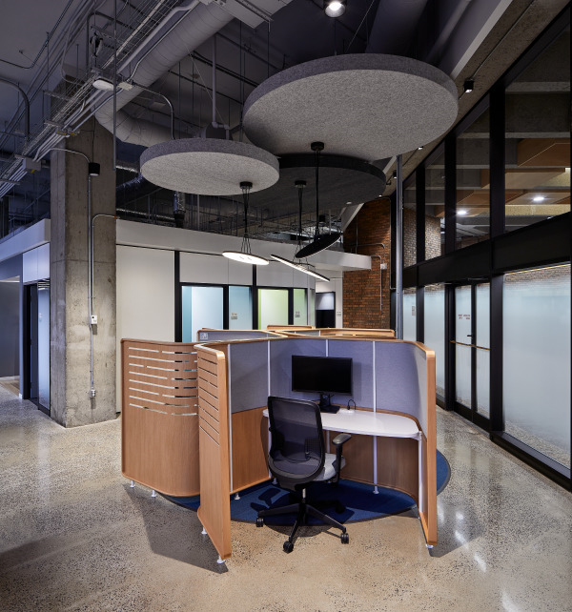
Transitional zone
Quiet zone
QUIET ZONE FEATURES FOCUS PODS
Notes:
We will now proceed to the Quiet Zone.
Determining zones and identifying them as such help inform users how the space should be used.
The Quiet Zone includes open, semi-enclosed and enclosed individual workpoints, such as focus pods and focus rooms. In these zones, the intent is to encourage individual focus work, to support the need for quiet or private spaces, in an area that should be free of distractions.
Noise levels here are expected to be lower than anywhere else on the floor.
By recognizing that all employees can benefit from an environment that supports focus work or time to recharge, GCworkplace is designed to support all occupants.
By providing proper zoning, GCworkplace ensures that noisier and more collaborative activities are performed away from quieter activities to minimize disruption.

Slide 6
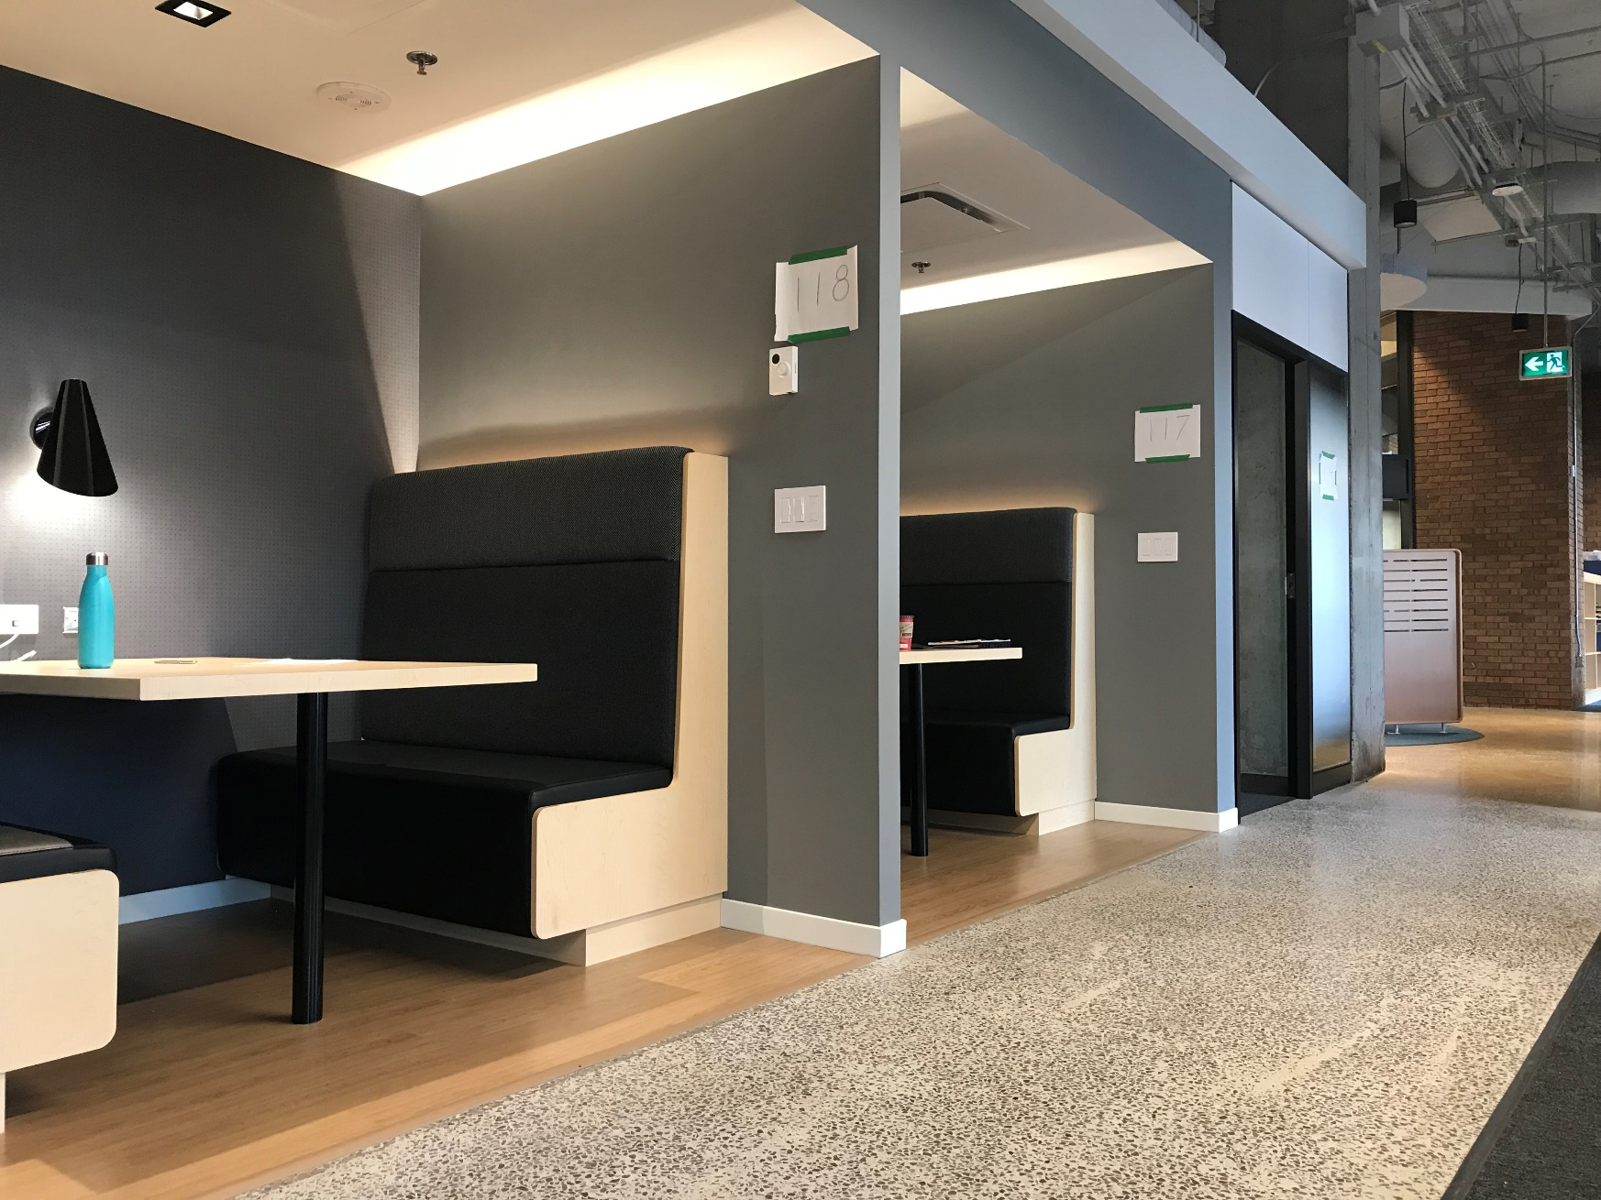
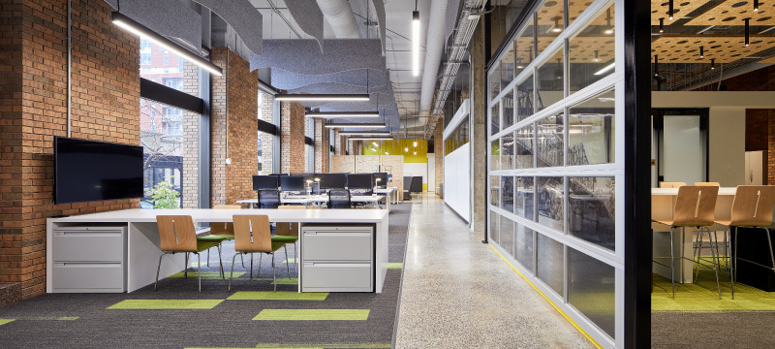
TRANSITIONAL ZONE
TRANSITIONAL ZONE
Notes:
This is what we call our Transitional Zone. It includes a variety of open and semi-enclosed spaces. We can find huddles, chat points or open workstations.
In a transitional zone, less intense concentration is supported.
Noise levels can be a little higher than the tranquility expected in the quiet zone, partly due to its proximity to the collaborative zone.
Noise cancelling fabric panels are installed to help control noise levels.
GCworkplace is designed to better facilitate collaboration by planning for a balance of individual and shared spaces. Collaboration can be encouraged by incorporating flexible furnishings and technological tools for sharing ideas and co-creating, as well as planning informal collision points for spontaneous interaction.
Since open collaborative workpoints tend to be used by multiple people, they can be disruptive to others if not strategically located. The plan is to have enclosed and open collaborative workpoints grouped together and have flexible furnishings used to define space in open areas.

Slide 7
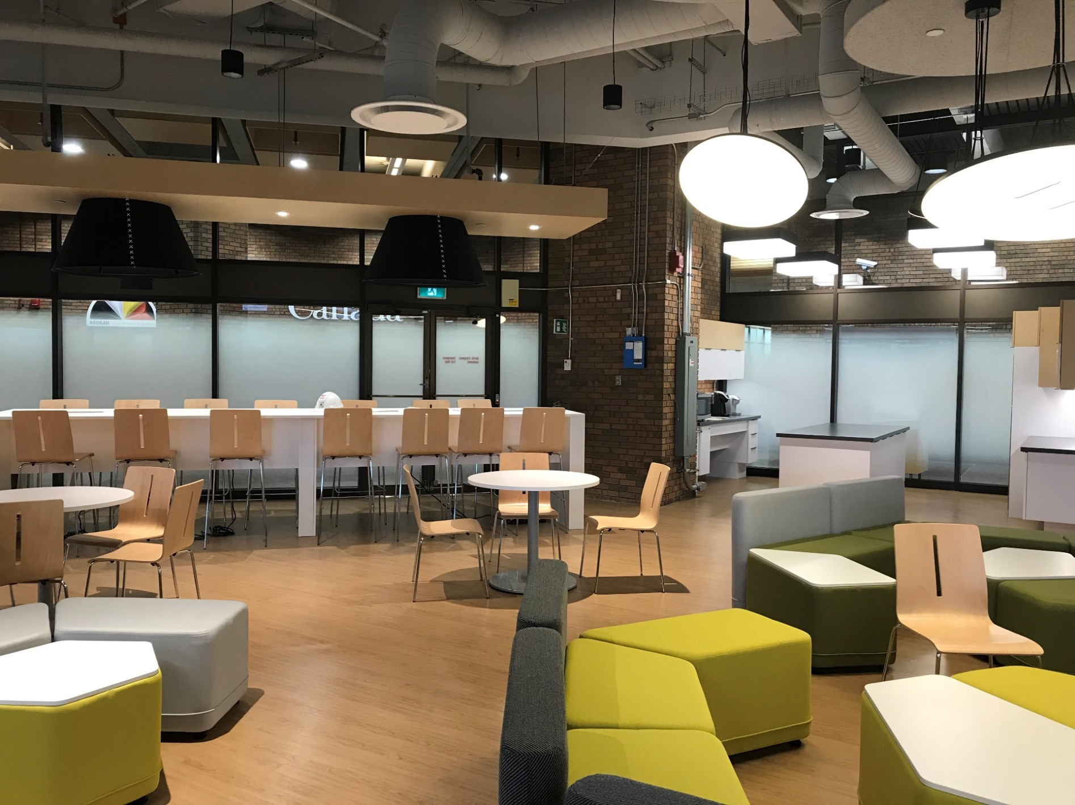
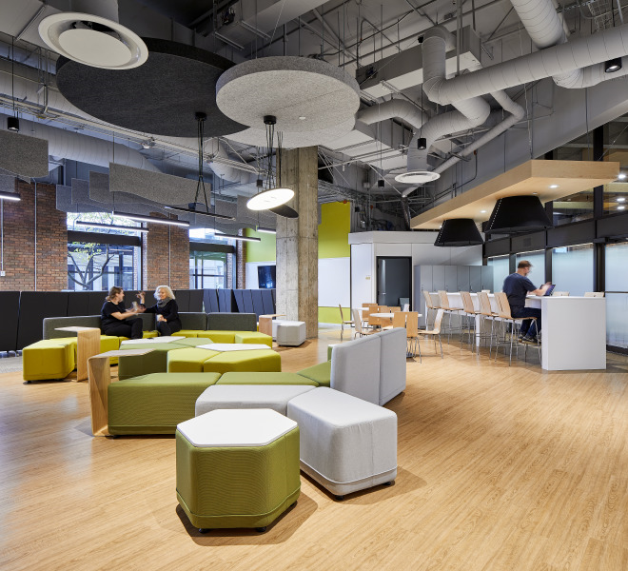
INTERACTIVE ZONE
INTERACTIVE ZONE
Notes:
In Interactive Zones such as this one, socialization and group collaboration are promoted and strongly encouraged.
Providing a variety of group workpoints and locating these activities away from the Quiet Zone, it is possible to achieve a balance within the workplace which supports all types of work activities and work styles.
Seating in the kitchenette can be used as workpoints.
The lounge is available for socializing but can also be used to host team meetings.
Large suspended light fixtures and ceiling panels with sound absorptive materials offer additional acoustic management in this large open area.
Collaborative workpoints are supported by a variety of tools such as mobile monitors and whiteboard to facilitate team work.
Proximity to the shared kitchen and dining lounge area creates more opportunities for impromptu interaction and informal exchanges between employees.
This open lounge area also doubles as extra seating to the large boardroom when the walls that separate them are opened up (ie. Townhall or all-staff activities).

