Slide 1
Next Generation HR and Pay
Update to the Public Service Management Advisory Committee
October 12, 2018

Slide 2
NEW APPROACH
NextGen is using a new approach to HR and Pay, with lessons learned from Phoenix.

Slide 3
Introducing the Next Generation of HR and Pay
Budget 2018 announced the government’s intention to find options for an alternative, long-term, and sustainable next generation pay solution.
A future HR and Pay system for the Government of Canada should be driven by a modern people management process and system.
The government will work closely with experts, unions, technology providers, and most importantly, our employees, to accomplish our goals.

Slide 4
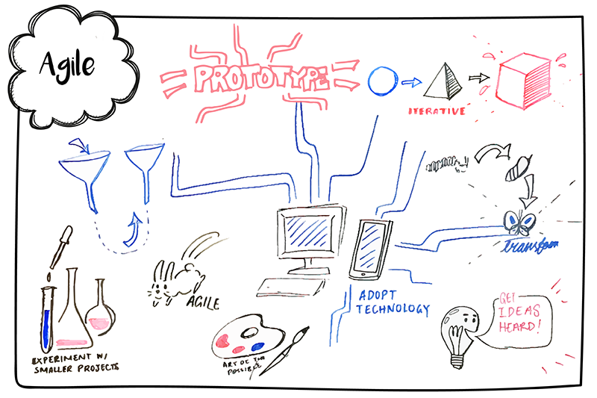
This is not Business as Usual
We are not defining complete requirements up front.
Iterative Development of our vision
Open and Transparent Leadership
Agile Approach to Project Management
Users at the heart of the process
We are not using the waterfall procurement and project processes.
We are not limiting user engagement to the end of the process.
Accountability does not rest with traditional committees.

Slide 5
Initiative Overview
Phases
Phase #1 Discovery & Analysis
Phase #2 Ideation & Experimentation
Phase #3 Implementation & Rollout
Gates
Objectives
Understand the problem, the users and the context. Set a vision and identify options. | Validate the options, finalize solutions and implementation plan | Deliver capabilities, realize benefits and transfer to operations
Vision for HR & Pay Target Architecture Service & Technical Options Recommendation | Validated solutions Successful pilot Implementation & change mgmt. plan Target service & operating model Detailed costing | Successful implementations Benefits
Spring 2019 | To be confirmed Target TBC | To be confirmed Multi-year implementation phase
Public servants are paid accurately and on time. The GC can attract, retain and nurture a highly qualified workforce through a clear vision for modern digitally-enabled enterprise-wide HR and Pay services.
Key
Outputs
Target End Date
Outcomes

Slide 6
PEOPLE FOCUSED
A new solution will require changes to existing processes, with employee and vendor involvement at all stages of design and delivery.

Slide 7
HR and User Centric
The Office of the Chief Human Resources Officer (OCHRO) is working in tandem with technical experts on the NextGen file.
OCHRO’s focus will be on
Establishing Vision
Advocating
Setting Business Outcomes
Identifying Service Levels
Readiness
Set a common, enterprise vision of HR, including compensation
Represent HR and user needs throughout the project
Describe, clarify (and re-engineer, as needed) the business architecture to support project implementation and HR modernization
Identify the expected service levels for application operations and support, looking to improve the business experiences of end users
Ensure that departments, agencies and end users are ready to adopt any new solution

Slide 8
Engagement is Built-in
Maintaining consistent engagement with our user communities and bargaining agents throughout the process will be fundamental to our success.
Engagement sessions held through a series of workshops in partnership with Ernst and Young.
Documents will be made available and open to the public.
Members of the public can reach out to the Next Gen team directly through a generic mailbox.
Sandbox environments will enable user testing and the opportunity for users to provide feedback.
Users - including employees, HR practitioners, compensation advisors, unions and managers - will be at the centre of any new solution.

Slide 9
AGILE
PROCUREMENT
We are engaging industry differently in order to identify the best options for a new HR and pay solution.

Slide 10
The Difference between Agile and Traditional Procurement
Agile Procurement Process
Smaller/Faster
Sprints
Gated Approach
Scope is flexible and adaptable
Interaction with vendors is ongoing
Enables industry feedback, best practices
Traditional Procurement Process
Process runs in its entirety
Long contractual periods
Scope is determined and set
Limited interactions with vendors
All requirements need to be known and documented

Slide 11
The Agile Procurement Process
Gate 1
Show Us
Gate 2
Let us
Gate 3
Convince Us
STEPS
Steps repeat for each gate
Feedback, refinements, open publication…
Phase #1 Output
Decrease in Number of Qualified Vendors
Step 1: Information Sharing
Industry Day
Pre-qualified list of bidders established
Step 2: Co-Design
Step 3: Development
Increase in Level of Depth and realism of Requirements
Spring 2019
Vision & Strategy
Target Architecture
Service & Technical Options and Recommendation
Step 4: Evaluation
Insights Gathered
Problem-Specific Challenges posted on Challenge Platform

Slide 12
Evaluating each Gate
Applicants through the Agile Procurement Process will be evaluated at each gate based on Government of Canada standards.
Gate 1
Gate 1
Show Us
Gate 1
Gate 1
Gate 2
Let Us
Gate 3
Convince Us
Will look for solutions and services that are proven, scalable and follow GC standards and principles
GC Digital Principles
GC Architectural Standards
More show, less tell
Use of real scenarios and case studies
Actual testing and interaction with users
Presentations, demos, real-time feedback…
Collaborate and Co-design implementation and innovation solution
Understand final costing and implementation scenarios
Develop key principles for sustainment.
The full Next Generation HR and Pay evaluation team will be multi-disciplinary and may change per gate and per stream.

Slide 13
WHAT’S NEW
Fall Update on the NextGen Initiative

Slide 14
Launch of Gate 1 – October 1, 2018
In the “Show Us” gate, vendors will submit:
Vendor commercial product videos based on government user stories
User experience mapping current & future product offerings to GC Business Capability Model
Mandatory criteria response and evidence
Forward looking product roadmaps for each key business capability
Data model & workflow (to provide mock data for Gate 2)
Costing model
Gate One will be open for a minimum of 40 days, closing on November 11, 2018.

