Slide 1
The hybrid workplace:
Modernizing our workplaces and workspaces
Date: 2022-09-21
Notes:
Good morning/afternoon.
I’m Sonia Powell, the Director General of Accommodations Management and Workplace Solutions for the Real Property Services at Public Services and Procurement Canada (PSPC).
I am pleased to be with you today to give the keynote speech for this first session in the Canada School of Public Service’s “Hybrid Workplace Series”.
The Future of Work is incredibly exciting, it’s happening right now, and I look forward to the panel discussion and Q&A session that will follow in today’s session.
But let me start with an overview of the hybrid workplace model and the ecosystem of workplaces we are creating for government employees.

Slide 2
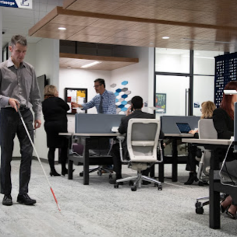
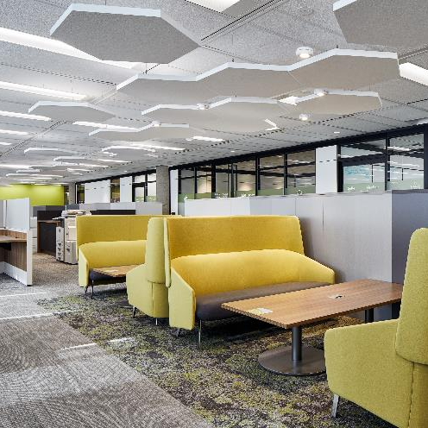
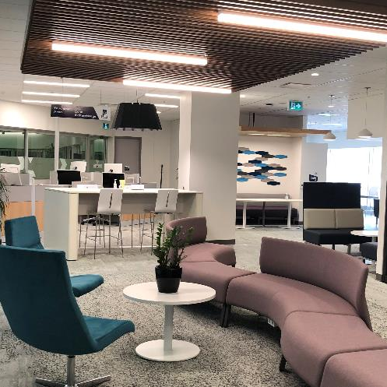
What is hybrid?
2
Notes:
Hybrid is a work model that provides flexibility and options – it allows GC employees to work anywhere, anytime within their department’s ecosystem of workspaces.
Instead of one dedicated workspace, a range of worksite options are available to employees and each space can meet specific needs – collaboration for large groups, quiet areas for individual concentration, special purpose sites with specific technologies, equipment or services, and working from home for focus and work-life balance.
The pandemic provided a unique opportunity for departments and agencies to rethink their workspaces, experiment with new ways of working, and return to the office with more efficient, modern and accessible work sites.
Quoting Treasury Board president, Mona Fortier, “Hybrid work is here to stay.”

Slide 3
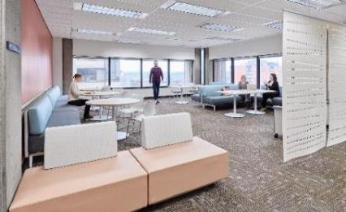
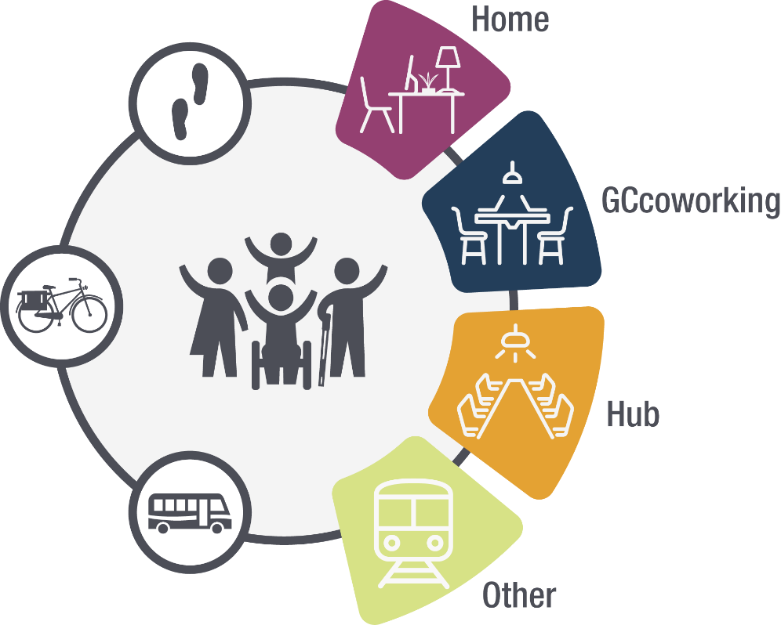
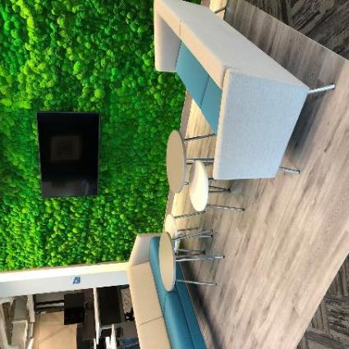
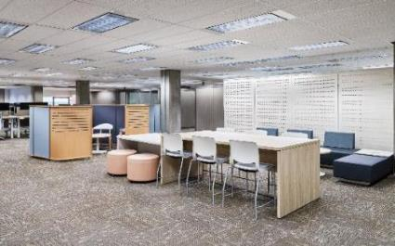
What does it look like in government?
3
Notes:
What does this hybrid work model look like in the government? It is a network of managed workspaces including departmental HQ hubs and additional spaces available to employees closer to home and across Canada, connected digitally via secure Wi-Fi and collaboration tools.
Departments can select existing modernized sites or engage in a GCworkplace fit-up to offer employees workspaces that support an agile, inclusive and equipped workforce – the vision of a digital, inclusive, healthy, flexible, efficient, collaborative and green public service.
The workplace offerings include the main headquarters or “hub”, as well as other “spoke” locations, including regional offices, operational sites, special purposes sites with laboratories or call centres, coworking sites - both the national GCcoworking and department specific coworking - and working from home or while in transit.
This decentralization at the city level, regional and national level offers employees flexibility on where to work. It also offers departments flexibility on where to hire, accessing a more inclusive and diverse workforce.
There isn’t a one-size-fits-all approach, since departments and agencies have different mandates, different responsibilities and achieve different outcomes.
Experimentation, management leadership and employee consultation will enable departments to make data-driven decisions, guiding them to find the mix of spaces that meets their departmental needs.
At PSPC we have been experimenting for the past year with options for our employees in the national capital including working at home, at operational sites, and at PSPCcoworking and GCcoworking locations.
Our experimentation includes a space occupancy pilot and the creation of a pan-GC site occupancy dashboard, incorporating data from multiple departments.
PSPC’s real estate portfolio is moving from ‘space as asset’ to ‘space as service’.

Slide 4
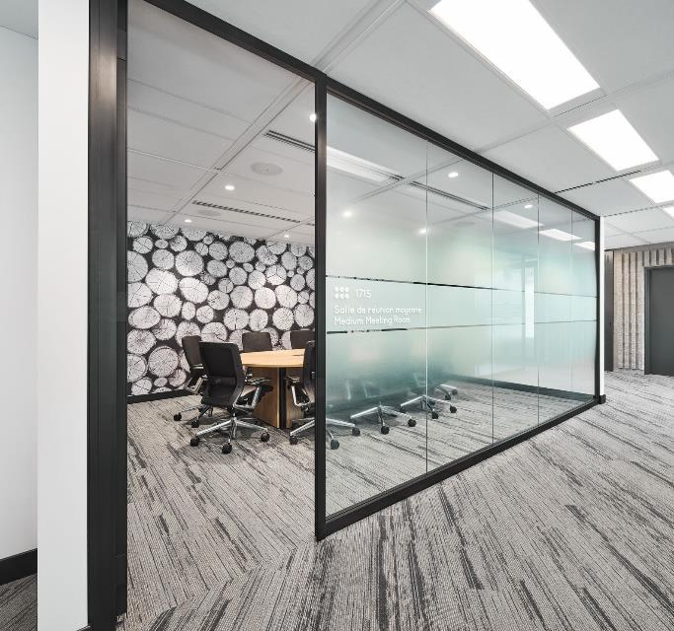
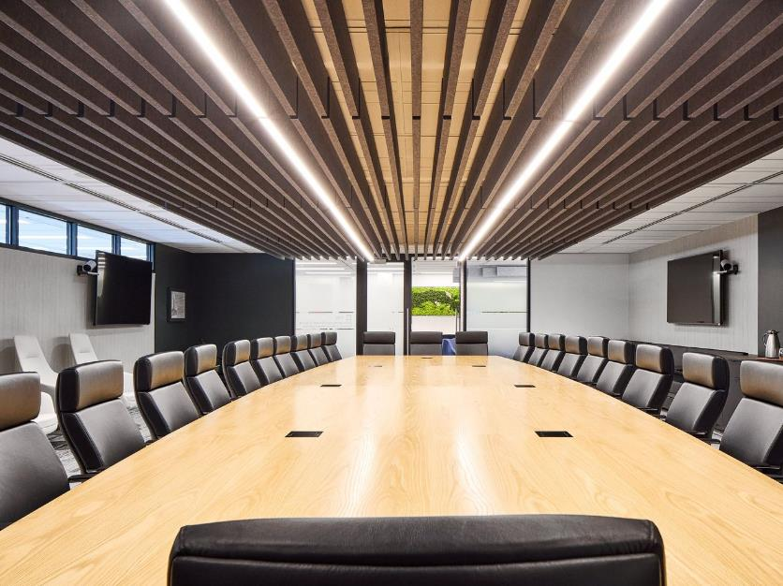
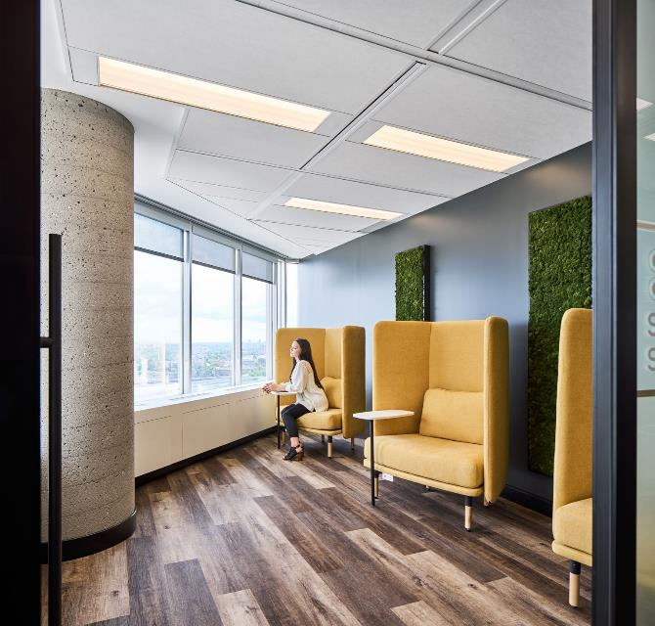
What are the benefits?
Notes:
The end goal is to have a flexible real estate portfolio that provided great work environments to better enable employees to deliver services to Canadians.
The hybrid work model accomplishes this providing myriad benefits to the Government of Canada and the public service employees.
For the government and departments, by choosing modernized workspaces and offering worksites closer to where employees live, the GC can help reduce greenhouse gases from commuting and inefficient buildings; the employee talent pool broadens beyond the physical location of the head office offering increased opportunity for a diverse and inclusive public service; and employees are more engaged with a better work-life balance reducing staff turnover.
For employees, they have choices on where and how to work, enabling them to make decisions that allow a better work-life balance, increasing job satisfaction and engagement.
Collaboration
Promoting positive group dynamics, social interactions, emphasis on collaboration and innovation
Greening
Promoting less commute time and distance traveled, enabling alternative modes of travel such as cycling, and giving time back the employee as well as lowering GHG
Autonomy
Providing access to a wide variety of work environments that are flexible, accessible, inclusive and adaptive to the personal needs and preference of different work styles that are digitally and technologically enabled
Wellbeing
Providing opportunities for stress reduction and enhancing employee wellbeing while encouraging heathy choices

Slide 5
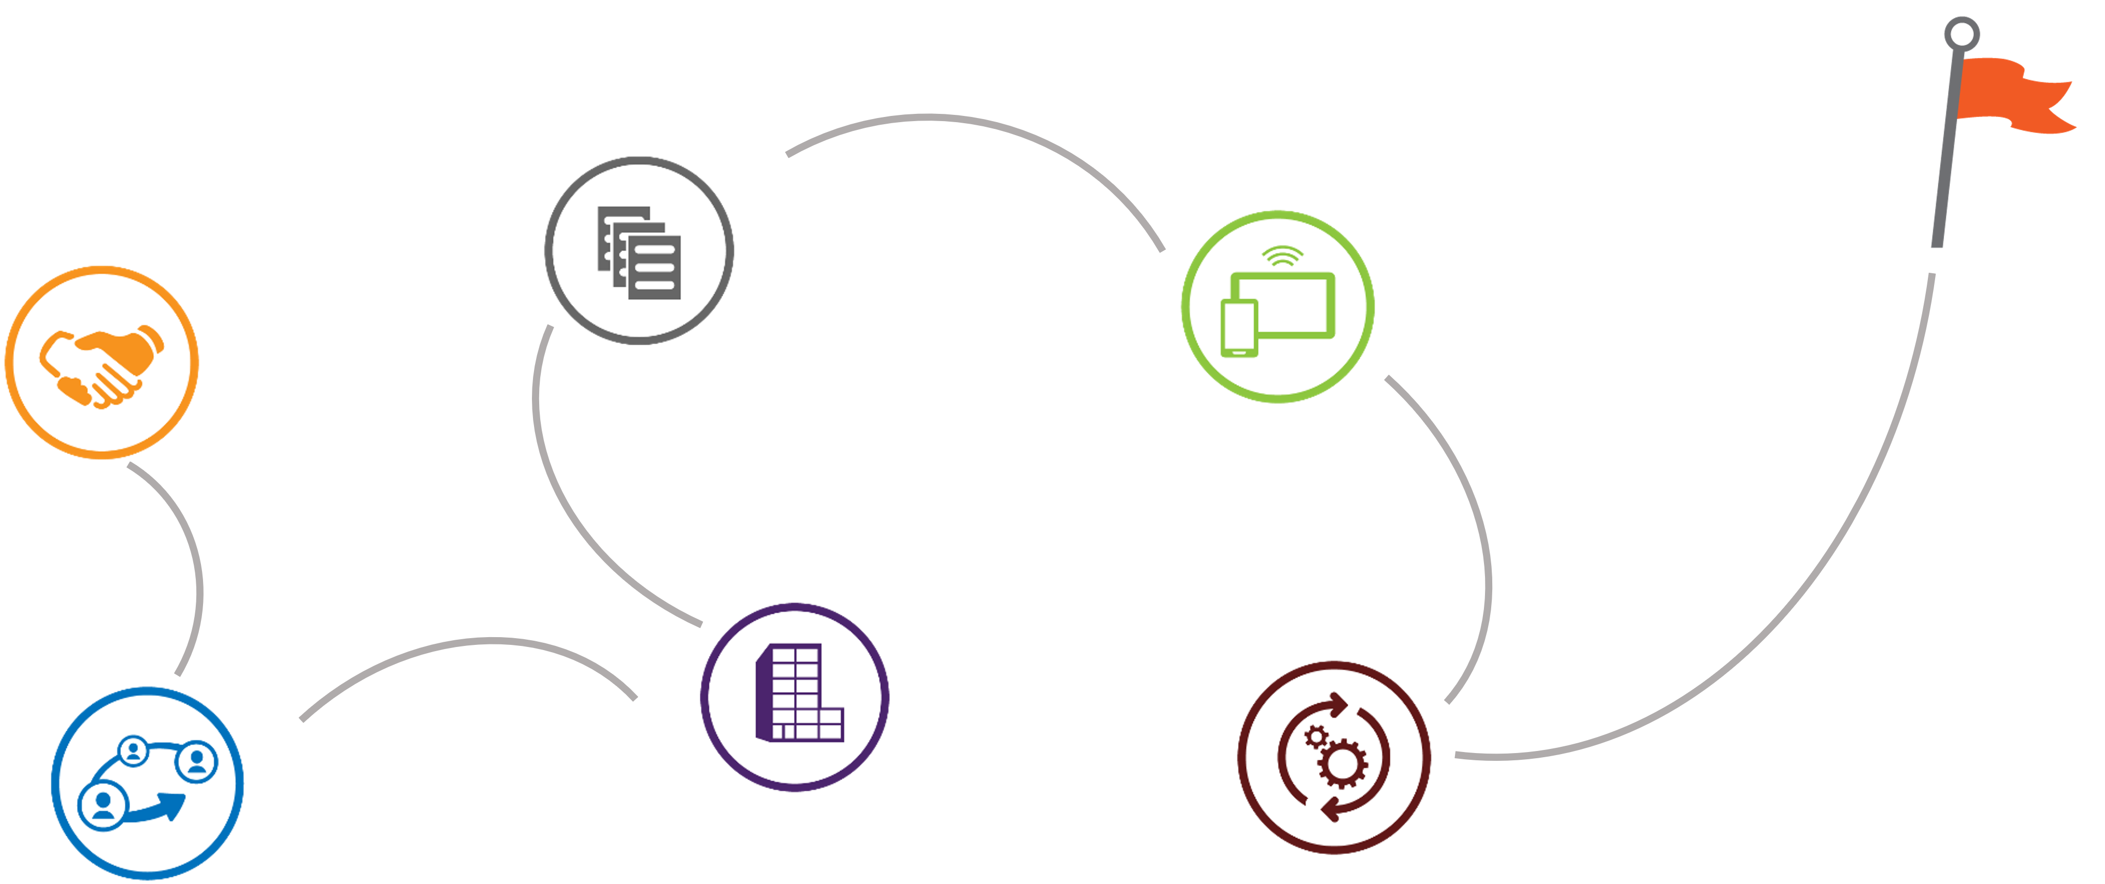
How do we adopt hybrid?
1. Create a Transformation team
Launch!
4. Prepare the worksites
5. Establish an experimentation plan
3. Evaluate and select sites
2. Connect and collaborate with employees and stakeholders
6. Plan for onsite resources and eventualities
5
Notes:
PSPC has created a guide to help departments move to a hybrid model and a GCpedia page to help their teams connect and share lessons learned, ideas and strategies.
The steps include:
Creating a transformation team;
Connecting and collaborating with employees and department stakeholders;
Preparing the worksites for occupancy – start small but be ready to scale based on demand for office space;
Establish an experimentation plan – gather data, analyze it and make data-based decisions;
Plan for onsite resources and eventualities such as OHS and floor wardens, office protocols, etc. ; and
Launch your worksites, adjust and adapt!
The steps sound simple, but the key success factors are planning, engaging the team, and managing the change with employees.
Each department needs to look at the spaces, the people, and the technology that will help the department move to a hybrid work model. Ask questions, look at options, be innovative and data-driven.

Slide 6
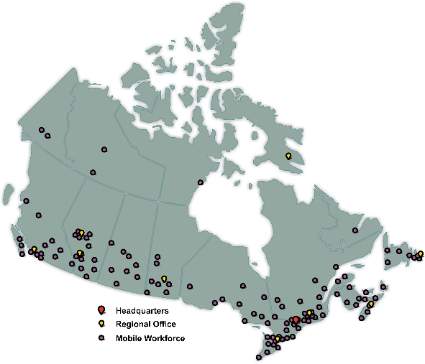
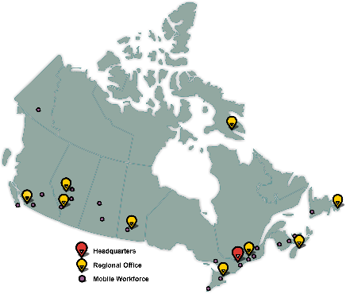
Bolder, Broader
“Hybrid…it can support a more nationally distributed and connected workforce and give employees increased flexibility that supports their well-being” - Janice Charette
6
Notes:
Our allies' national public services and some of our provincial governments plan to decentralize between 5% and 10% of their employees from their capital cities.
The need for Hub and Spoke implementation is now.
A GCcoworking site will be included every kept federal building.
Each Service Canada office will have at least a GCcoworking workstation.
PSPC’s “Matchmaking” program will connect departments needing space with other departments who have extra.
Offering multiple worksite options is the future of work and this is the hybrid work model – the OneGC approach to office accommodation.

Slide 7
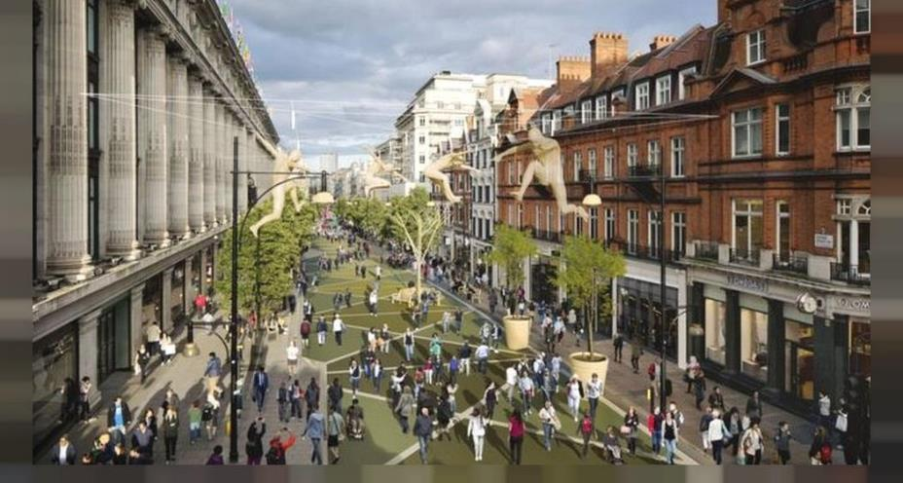
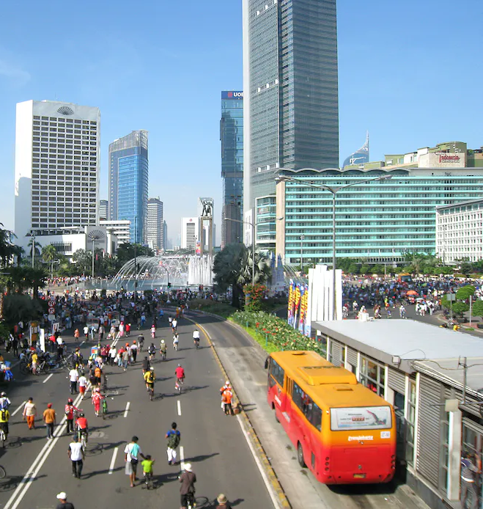
7
Notes:
Let’s dream a bit bigger for a moment to a possible future.
The 15 minute city.
A public service no longer in a distant national capital or a faceless concrete tower, but in every community, employing members of every community, reflecting the diversities of experience and perspectives of those communities.
Creating a OneGC experience, going even beyond simply federal services – the possibility of collaboration with all levels of government:
Coworking sites where any public servant – municipal, territorial, provincial, federal, First Nation – can collaborate and work together, in their communities.
Service centers where you can file for a building permit, a provincial license and your federal passport in one location.
We are creating a future of government work by and for Canadians in their communities.

Slide 8
As we establish how we will operate now and in the future, we have an opportunity to blend the best of our traditions while leveraging emerging workplace models to foster a diverse and healthy public service that is trusted to effectively deliver for Canadians.
—Janice Charette
8
Notes:
We are at an exciting moment for the Public Service – we have the opportunity to not only influence, but change how we work, improve how we serve and represent Canadians. Now is the time to experiment with the hybrid model, to collect feedback from our employees, and act to make the workplace of the future work for Canadians. And that is what this session is about.
It is my pleasure to welcome everyone to this first session the Canada School of Public Service’s “Hybrid Workplace Series” where you’ll get to hear from forward thinking leaders and have a chance to engage and ask questions.

Slide 9
Thank you
Sonia Powell
Director General
Accommodate Management and Workplace Solutions, Real Property Services
Public Services and Procurement Canada, Government of Canada
Sonia.Powell@pwgsc-tpsgc.gc.ca@pwgsc-tpsgc.ca
9

