Slide 1
Data Access at Statistics Canada
Analytical Studies and Modelling Branch
March 12, 2024
Notes:
Good Morning everyone, I'm very pleased to give you a portrait of the evolution of data access in Statistics Canada and share our experience.

Slide 2
Statistics Canada Data Access Services
What we offer: Accessible representational meaningful data about Canadians for Canadians
Notes:
This diagram represents the full continuum of data access offered in Statistics Canada
On the previous slide, I focused on the solutions framed in purple.
Each column of this diagram represents different data products starting with self-serve options on the left side, evolving toward secure access on the right side.
We strongly encourage all data users to consider public data first.
We only authorize access to confidential microdata when we have a clear demonstration it is a necessity.
*Mention more details in appendix

Slide 3
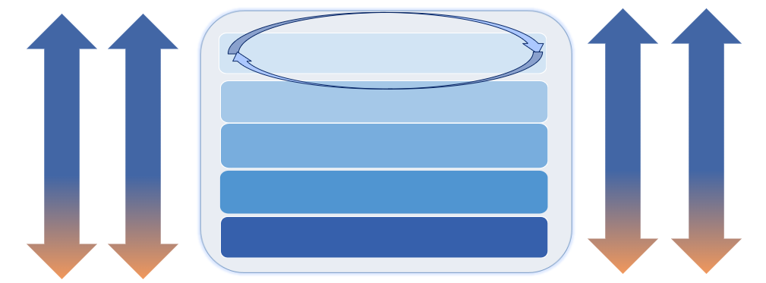
Using the Five Safes Framework as Guiding Principles
Safe People
Safe Projects
Accreditation of data users and sharing accountability with host organization
Safe Data
Review and approval process
Security and monitoring requirements
Treatment of datasets – vetting of output
Safe Settings
Safe Outputs
The 5 Safes are considered in combination - and on a sliding scale - depending on type of researcher, access and data.
Notes:
The adoption of the 5-safes framework, developed in the U.K., has been the central piece of our shift toward virtual access
We are using it to mitigate the risk surrounding data access and we pivoted toward a risk sharing approach with all our stakeholders accessing data.
I'll describe briefly what we added to our existing risk mitigation measures.
Under Safe People:
We developed an organization accreditation process.
Accredited organization need appoint a Data Access Liaison. This person has the responsibility to vouch for their researchers accessing data and foster the same culture of confidentiality
Researchers affiliated to an accredited organization can access data from their home or office. Without an affiliation, they need to access on Statistics Canada premise.
We also increase mandatory training before access is authorized
For Safe project:
We strengthen our review process to ensure there is a need to access confidential microdata that the research goals are aligned to Statistics Canada mandate
Safe Data:
We use a confidential classification tool to score the sensitivity level of all data sets available for access
This score is use in combination to the accreditation to decide if access from authorized workspace is possible.
Data set that have a score of 9, which is the highest, need to be accessed from StatCan premise.
Safe Settings:
While we always had a very secure infrastructure, operating in the cloud is different.
We are now use a 2-factor authentication to log in the environment.
Once logged in the environment, researchers are completely isolated. They can't browse the internet, they can't import neither export data.
We also enhanced our monitoring
Safe output:
We maintained the confidentiality vetting rules applied on all research output.
Researchers cannot extract their output themselves, we proceed to a verification and send it to them.
For self-serve tabulation produced in our real-time remote access systems, this process is automated.

Slide 4
What is the Virtual Data Lab?
The Virtual Data Lab (vDL) is a secure cloud infrastructure used to store and access microdata research projects.
The vDL allows researchers a more flexible approach to accessing Statistics Canada microdata that includes monitoring controls and built-in vetting management.
The VDL allows for the use of “authorized workspaces” for eligible projects, providing qualifying researchers the ability to access their microdata project while teleworking from home or working from their own office location.

Slide 5
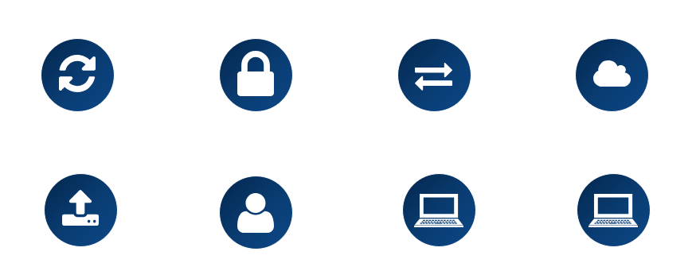
Highlights and Features of vDL
Secure 24/7 remote access
Robust IT security measures
Shared-risk approach
Housed in Collaborative Analytics Environment
Secure importing/exporting from environment
Two-factor authentication
Monitoring and reporting capabilities
Replaces requirement for secure room

