Slide 1
GC Business Architecture Community of Practice
Employment and Social Development Canada (ESDC)
QualiWare Demo
May 16th 2022

Slide 2
Purpose
The following slides contain screen shots captured during a QualiWare demonstration provided by Employment and Social Development Canada (ESDC) as well as questions posed and answers provided by ESDC representatives.

Slide 3
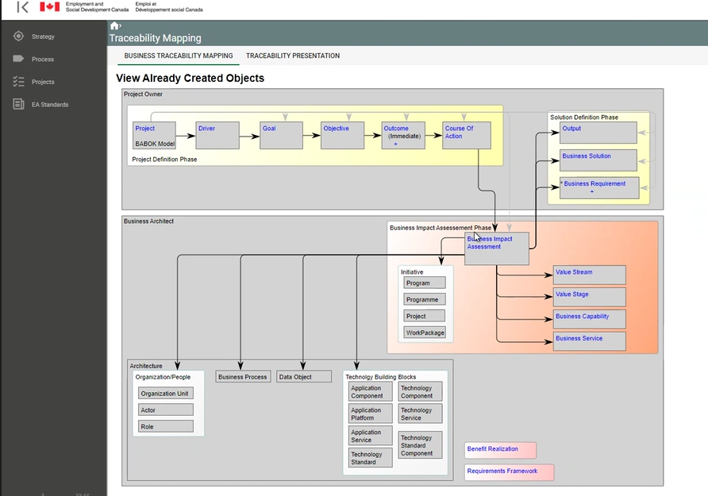

Slide 4
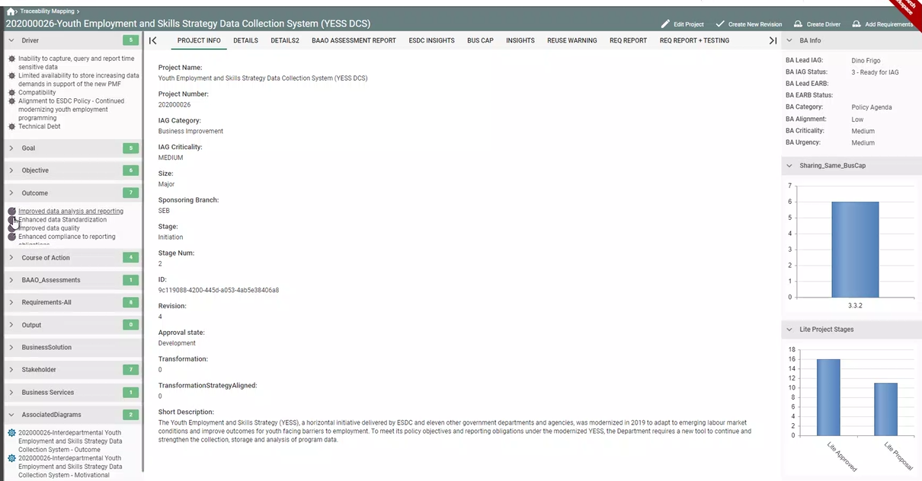

Slide 5
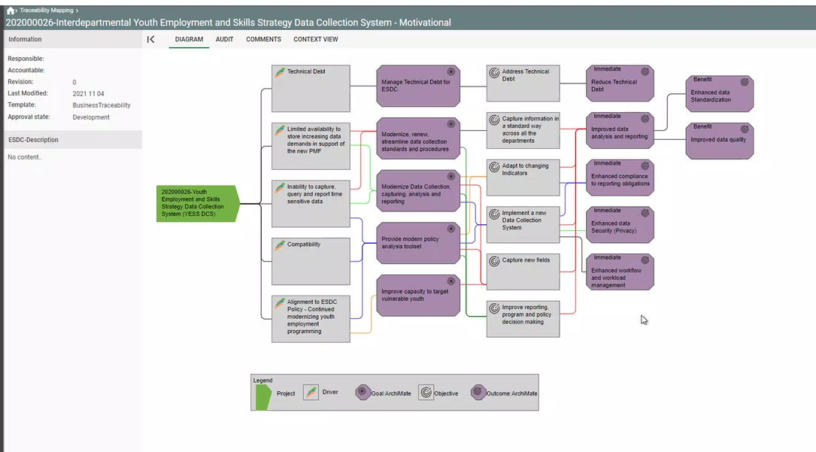

Slide 6
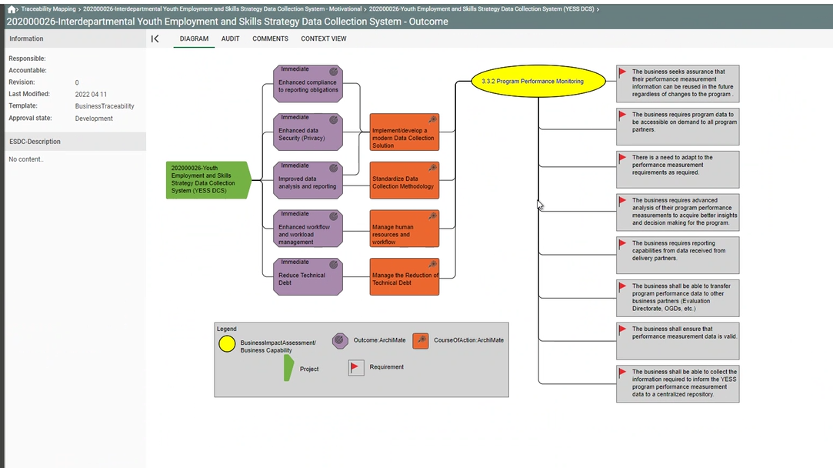

Slide 7
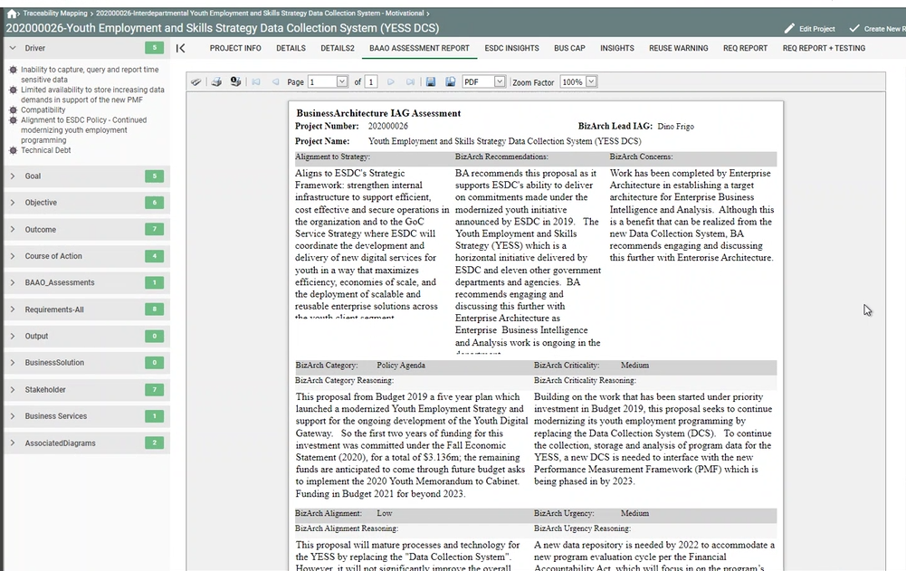

Slide 9
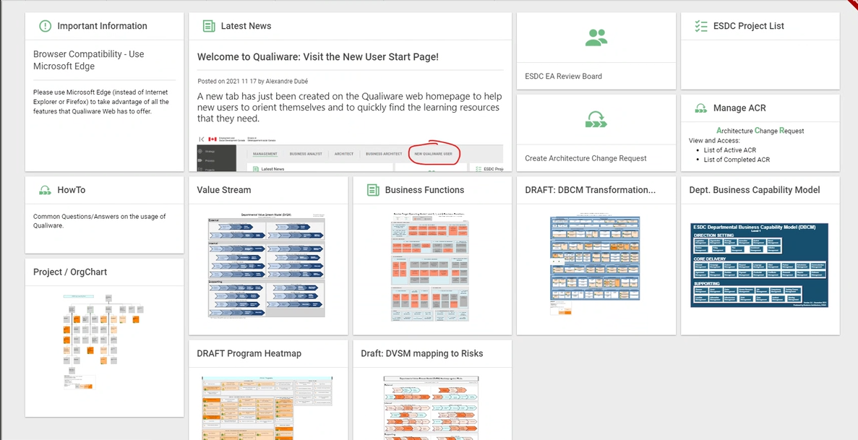

Slide 12
Q&A
Question | Answer
Do you have a script or questionnaire you use with the clients in your initial discussions? | Yes.
Do you track Goals / Objectives / Strategies per Business Function (e.g. HR, Material Management, Info Management, Finance, ...)? | Not really. We focus more on capabilities and value streams.
Do you do this as pre-approval gating for projects or more as a post-mortem? | Yes. We are involved in Stage 0. We help to develop their proposals. We prefer to sit at the strategic level to help clients plan the initiatives.
How different would the view or overlay be from a Programme perspective instead of projects and Enterprise? | Today we are able to make that link to Programmes as well. Working on Benefits Programme as well.
Does the ESDC architecture exist in a single repository? | Yes.
Do you have a list of the tombstone data (fields) you pull from your departmental Project Management Information Solution (PMIS) into QualiWare? | We could provide that.

Slide 13
Q&A
Question | Answer
How does the info you capture in QualiWare helps you to complete the mandatory fields in GC EPM (Clarity)? Enterprise Portfolio Management Resources And Training Materials – GCpedia | We’ve made attempts to link MAF reporting to these elements and have yet to be successful in getting buy-in from groups maintaining those reports in excel today.
Have you developed your own template to clarify what a project will do? At CBSA, we leveraged the TBS Concept Case template. | We contribute towards the development of those templates, but do not generate them from QualiWare.
Can you share your new BCM? I'd love to post them in out community page. I would also love to have the new BCM if it is possible to share.
How does this link to internal Architecture Review Board (ARB) processes? | We provide the heatmaps and assessments to the internal ARB. We are working with the ARB team to auto generate more material right from QualiWare.
Does the Value Stream model map into the Capability Model? | Yes.

Slide 14
Q&A
Question | Answer
How do you handle synchronization of English and French versions when updating a concept/model that was approved previously? | This has to be delt with as a quality approval. The translation suite is also a good tool to support this process.
Is ESDC/QualiWare used to spawn projects, split projects, show intra-relationships between projects? | We aim to get involved early and provide insights on overlaps or gaps. We want to get to a point were we develop strategy and get across silos. It is a very big organization and it’s very useful to get this type of view.

