Slide 1
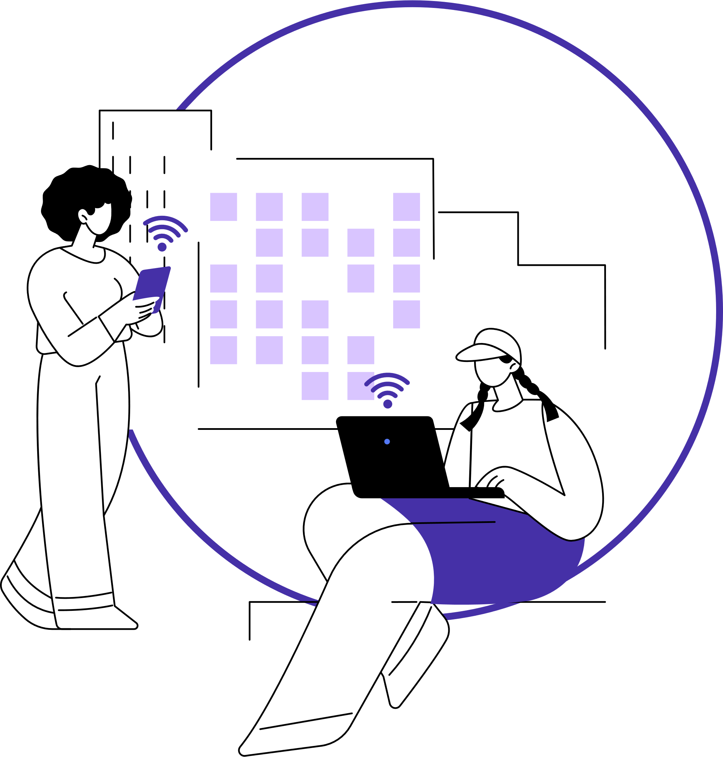
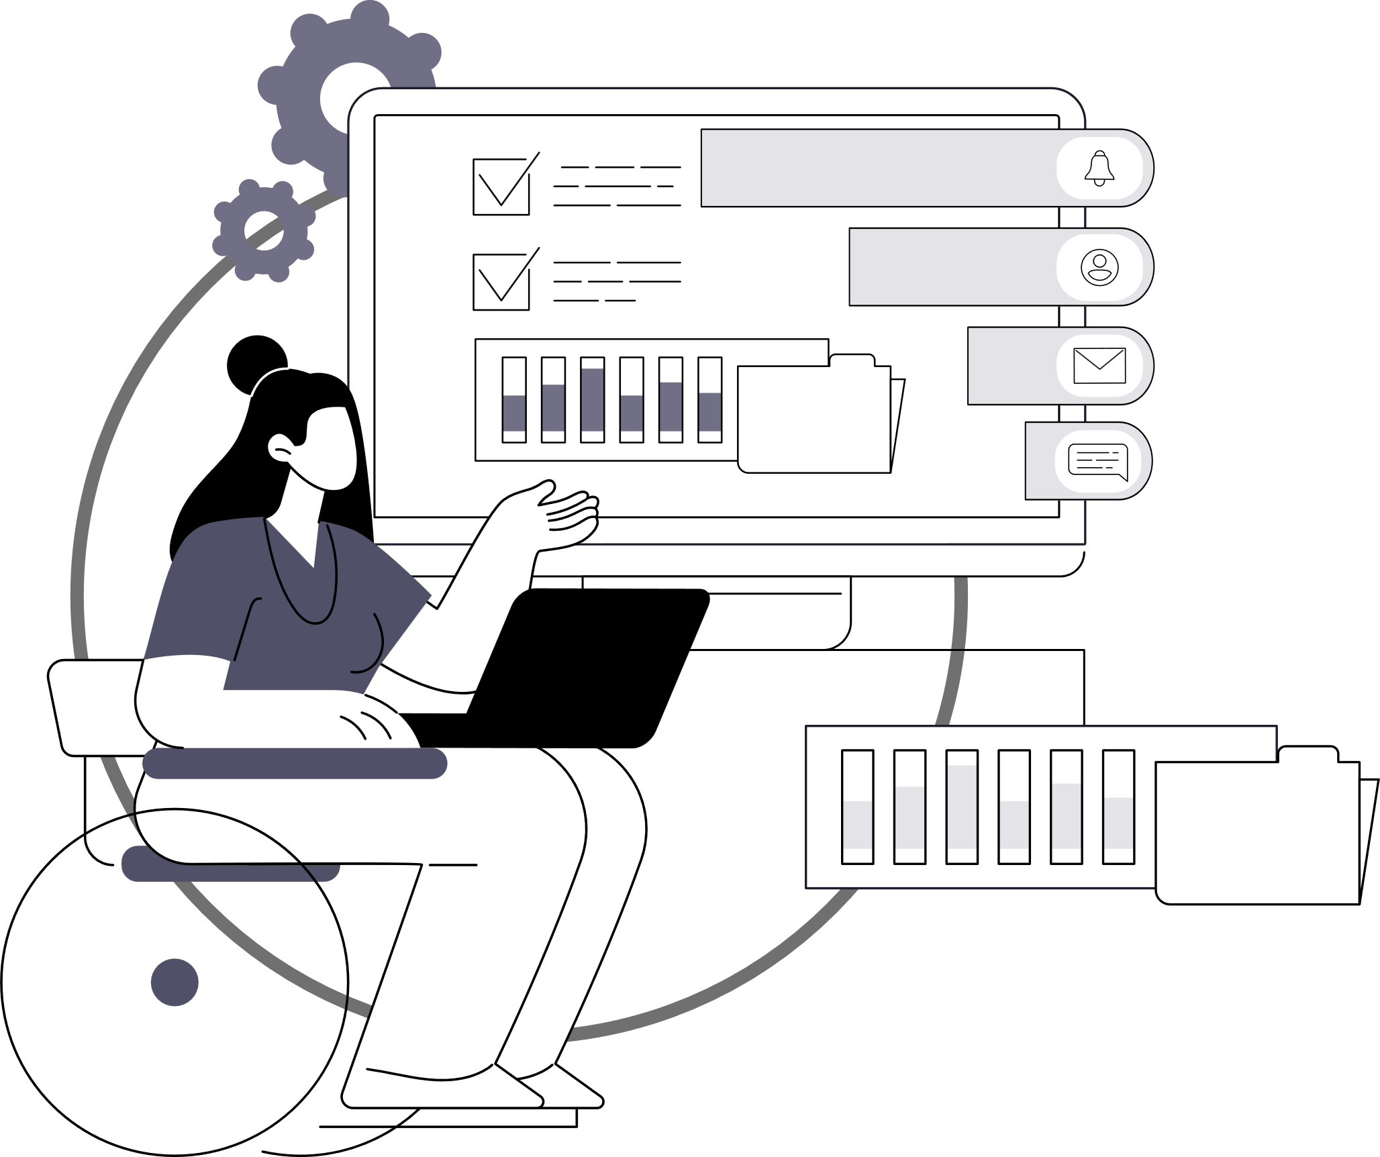
Shared Services Canada — Delivering Digital Solutions Together for Canada
Connectivity Services
Hosting Services
Digital Services
Cyber Security Services
An approach that meets the needs of users by leveraging commercial and public networks and wireless technologies.
An approach that supports a reliable and sustainable hosting ecosystem where workloads and enterprise application data can be transferred across GC infrastructure at speed and scale.
An approach where users have a common digital experience with full access to a standardized core bundle of tools, anywhere at anytime, from any GC-approved device.
An approach where users can seamlessly and securely access the tools they need through a single secure digital identity.
Innovation and Service Evolution
Exploring cutting-edge, state-of-the-art technology to discover and deliver innovative solutions to clients and partners that meet users’ needs and business requirements.
Digital Together
Vision
Service delivery focusing on achieving service excellence through more transparency, predictability, responsiveness and accountability.
Powering world-class technology for Government

